Slide 1
Gesture Drawing
Observational Drawing Unit

Slide 2
Learning Targets
I can use different approaches when beginning a drawing, such as a contour or gesture drawing.
I can complete an original drawing based on my observation and discovery.
I can learn to take creative risks.

Slide 3
What is Gesture Drawing?
Fast, quick drawing of objects, places or people.
Usually done in just a few minutes OR seconds.
https://www.youtube.com/watch?v=eRTqpJMs98E
https://www.youtube.com/watch?v=rmT7gEgwexc

Slide 4
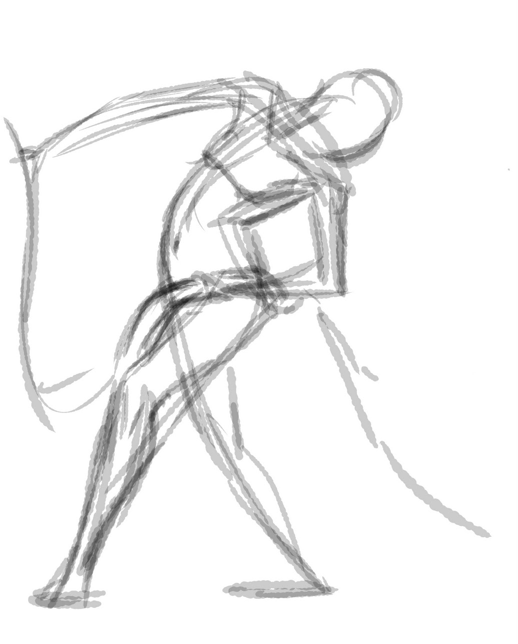
Gesture Drawing
Used to capture the emotion of feeling of the pose.

Slide 5
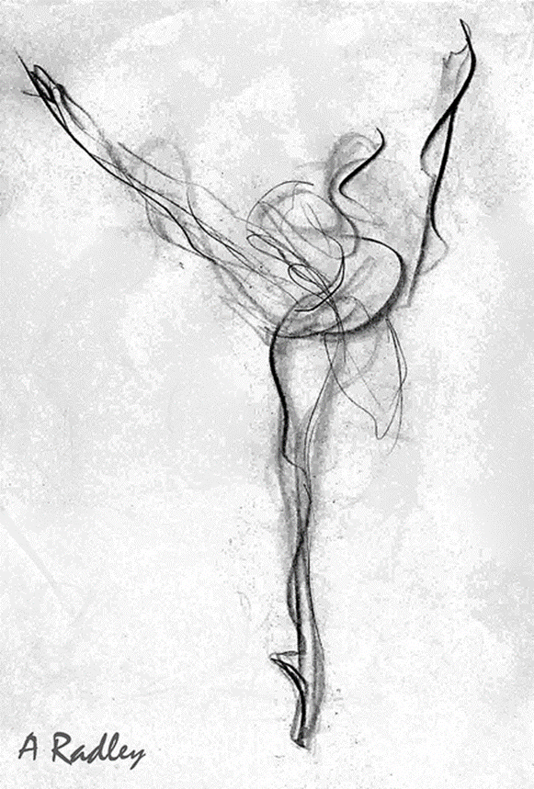
Gesture Drawing
Captures the movement of the person being portrayed.
Not concerned with details!

Slide 6
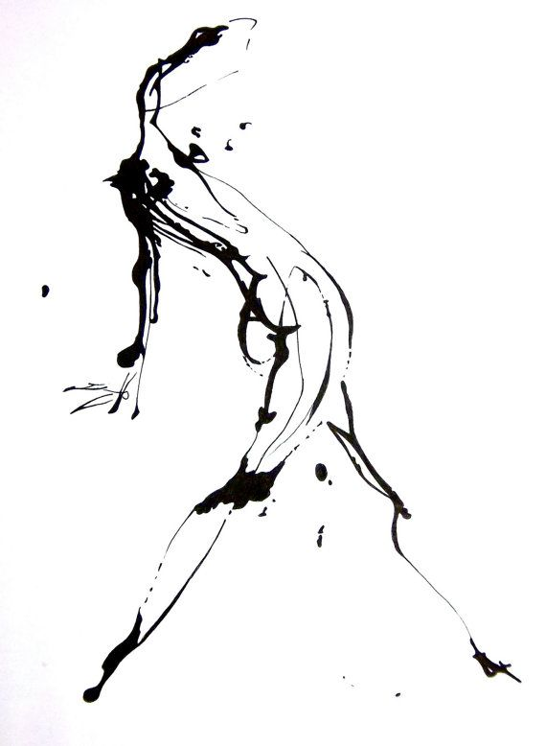
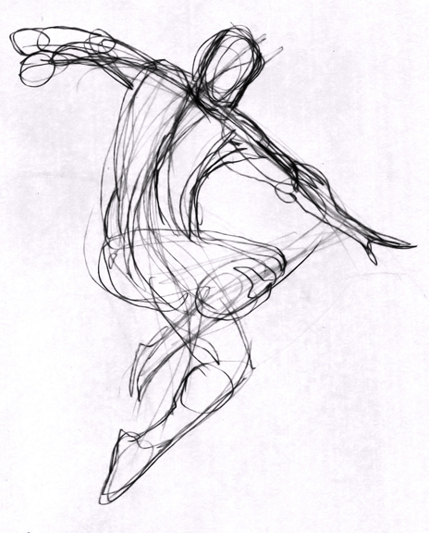
Gesture Drawing
Using dark and light, thick or thin lines can give the figure visual weight and more visual interest.

Slide 7
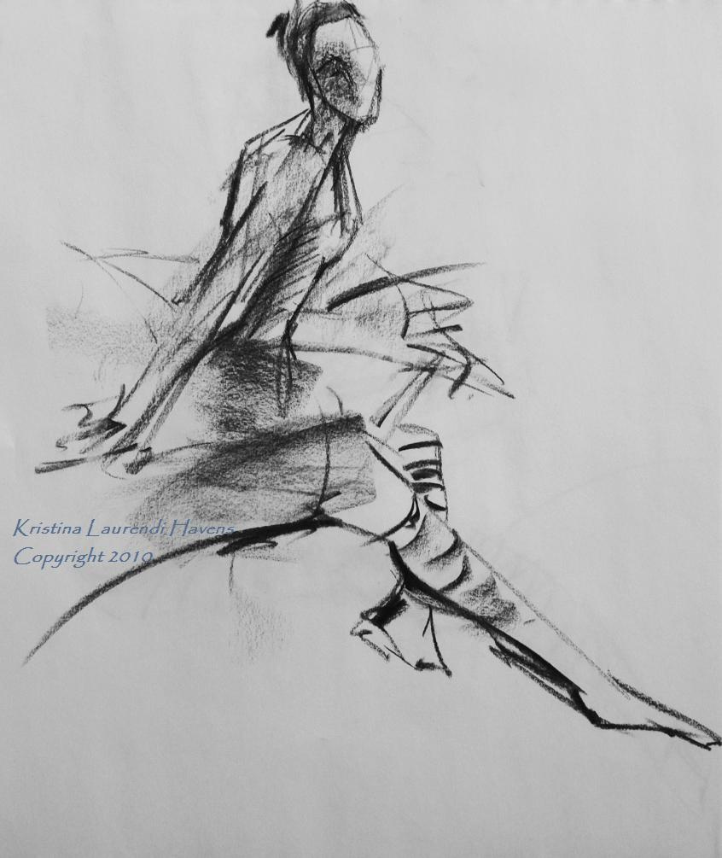
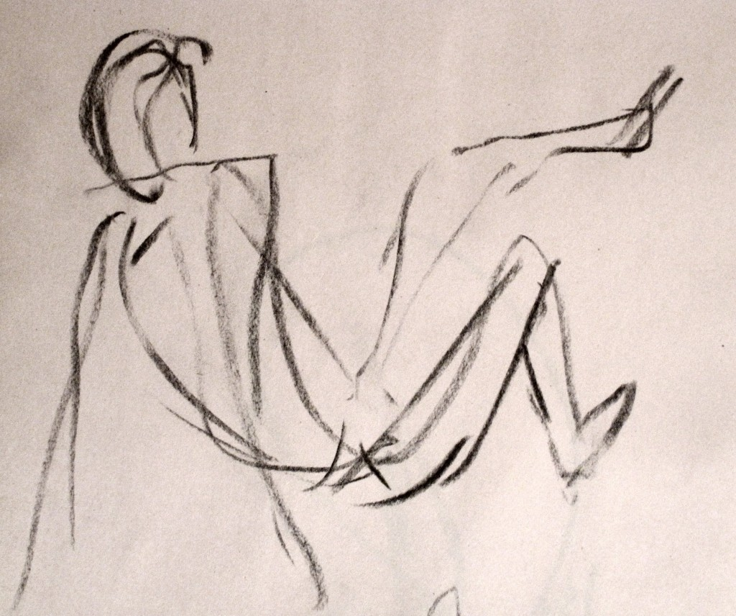
Gesture Drawing
Usually uses “C” curves, “S” curves and very few straight lines to begin the piece.

Slide 8
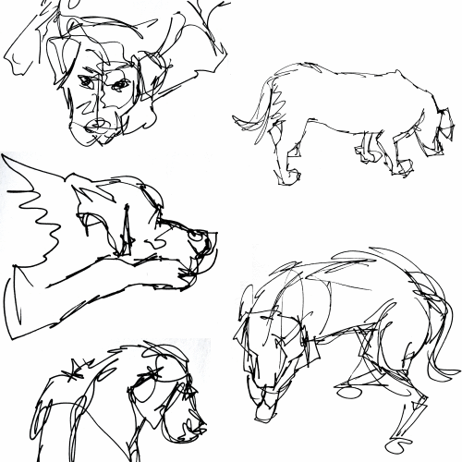
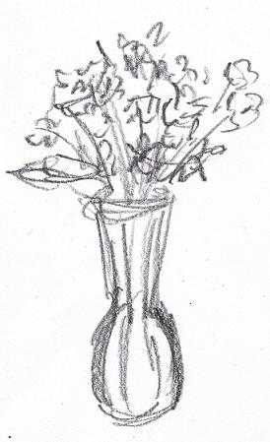

Slide 9
Gesture Practice
Poses!
Start with 3-4 minutes then move down to 1 minute.
http://www.posemaniacs.com

Slide 10
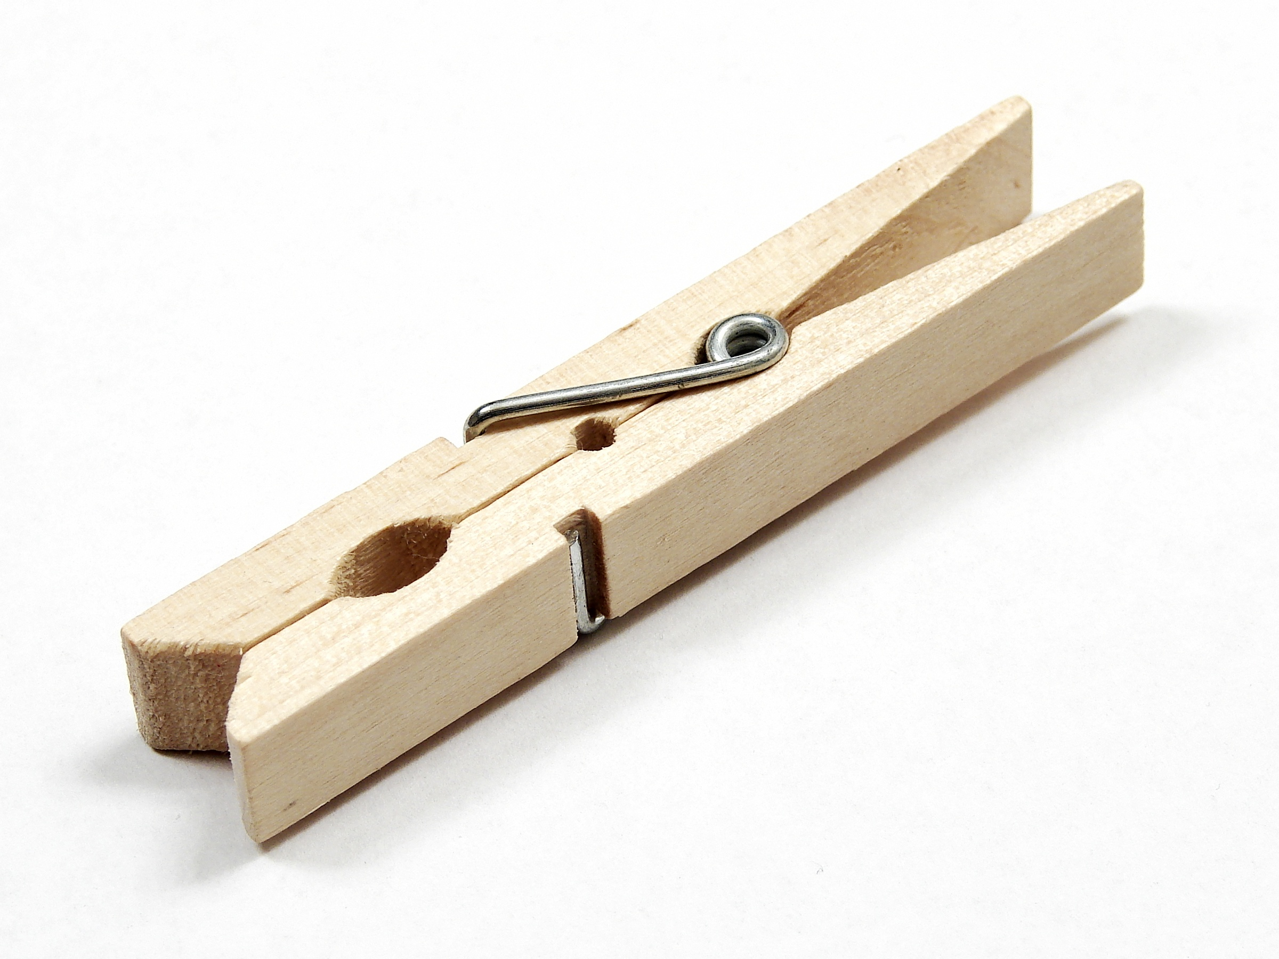
Draw!

Slide 11
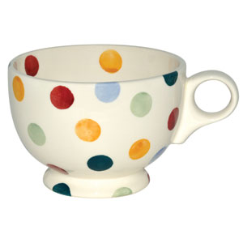
Draw!

Slide 12
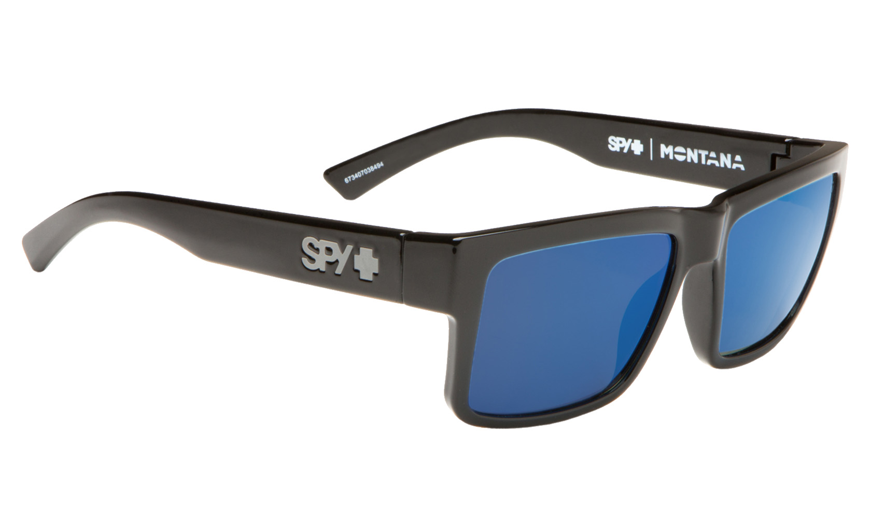
Draw!

Slide 13
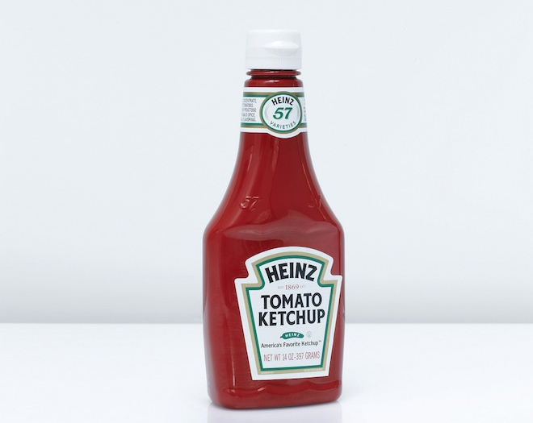
Draw!

Slide 14
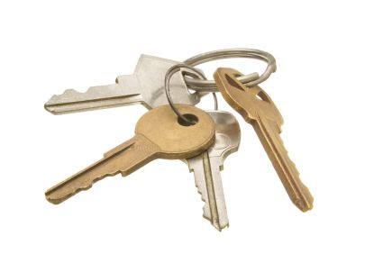
Draw!

Slide 15
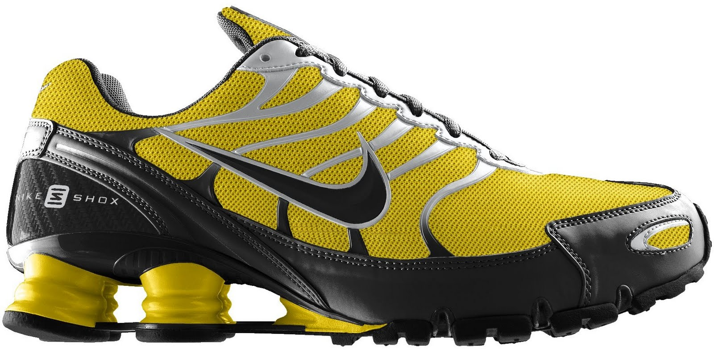
Draw!

Slide 16
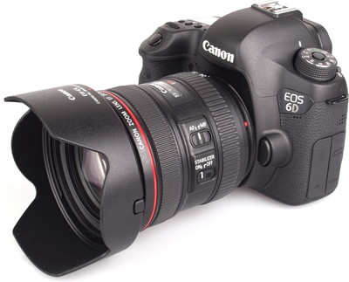
Draw!

